Slide 1
Service Configuration and Coordianation Systems
Pravin Y Pawar

Slide 2
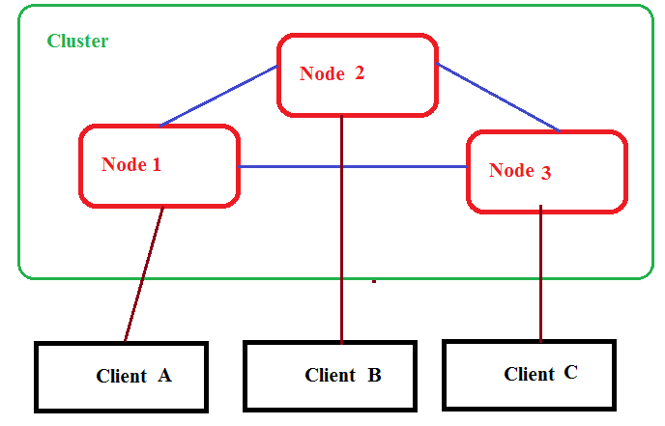
Distributed Applications
Overview
Run on multiple systems in a network at a given time simultaneously
Systems coordinates among themselves to carry out task in fast and efficient manner
Collection of systems is “Cluster”
System is termed as “Node”
Client communicates with the systems in cluster

Slide 3
Motivation for Configuration and Coordination System
Need
Applications needs to share the metadata and state
Metadata is configuration information
Example, location of various database shards in server
System state is data used to coordinate the application
Example, server currently acting as master

Slide 4
Motivation for Configuration and Coordination System (2)
Need (Continued)
Managing metadata and state is too difficult
Often leads to incorrect server behavior
Causes unaccepted delays in processing or missed the processing entirely
Needs a system-wide service that correctly and reliably implements distributed configuration and coordination

Slide 5
Distributed State Management
Challenges
Unreliable network connections
Clock Synchronization
Consistency in applications state

Slide 6
Distributed State Management (2)
Unreliable network connections
Networks are unreliable
Latency varies from time to time
Bandwidth changes
Connections are lost
Split brain problem
Loss of connectivity between two groups of systems
Some amount of state is inaccessible
Disallow changes to distributed state until connectivity restored back
Allow one partition to remain functional while degrading the capabilities of other partition

Slide 7
Distributed State Management(3)
Clock Synchronization
Depending upon type of application, synchronization needs to be precise
Hardware clocks in servers not perfect and tend to drift over time
May lead to disordering in the events

Slide 8
Distributed State Management(4)
Consistency in applications state
State in distributed system has to be consistent in any case of failure
Paxos algorithm or Multi-Paxos helps in maintaining the state
But notoriously difficult to implement
Recommended to use systems that already has implementations for the same

Slide 9
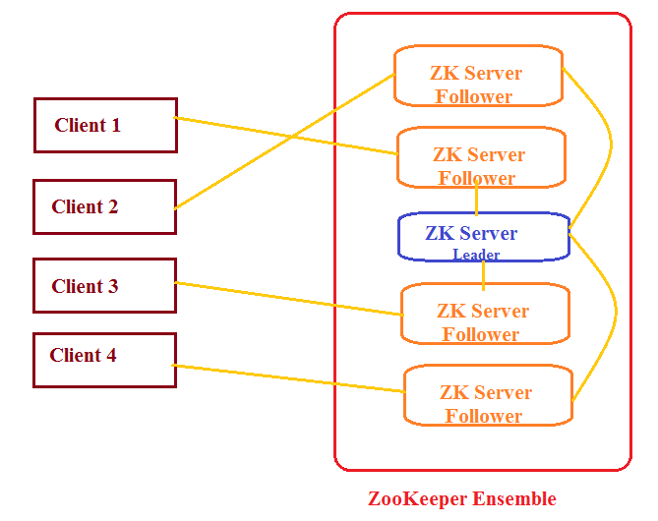
Example System
Apache ZooKeeper
Designed at Yahoo!
Distributed co-ordination service to manage large set of hosts
Simple architecture and API to manage a service in a distributed environment
Standard for organized service used by Hadoop, HBase, and other distributed frameworks

Slide 10
Thank You!
In our next session: Data Flow Manager

